Slide 1

THE 2023 & 2024 TRICS DATA COLLECTION PROGRAMMES
HARRY SUMMERFIELD, TRICS CONSORTIUM LIMITED
Notes:
In this presentation I am going to be discussing the 2023 and 2024 TRICS data collection programmes, as well as discussing the process we go through from the planning of the survey programme to putting the sites we have surveyed onto the database.

Slide 2
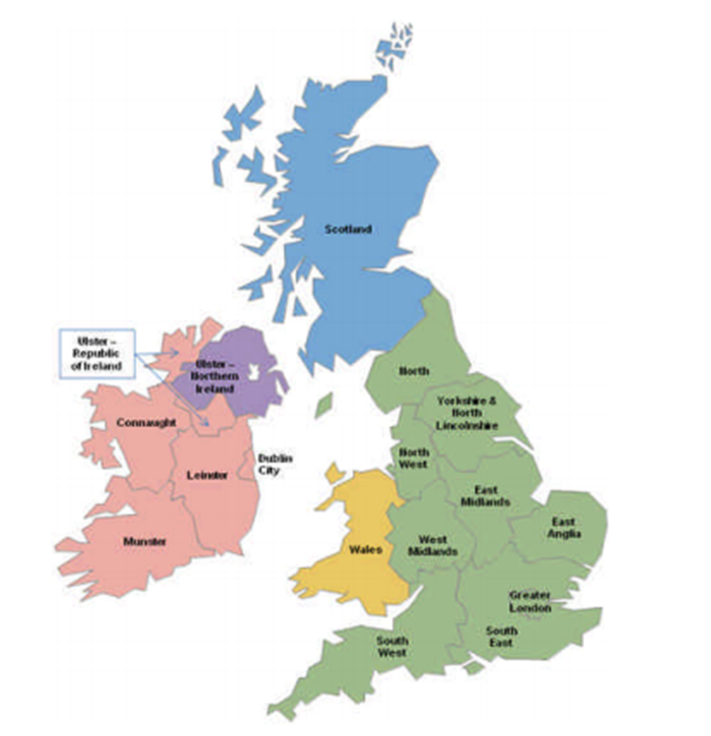
TRICS DATA COLLECTION REGIONS
Greater London Wales
South East Scotland
South West Greater Dublin
East Anglia Connaught
East Midlands Munster
West Midlands Leinster
Yorkshire & N. Lincs Ulster (Rep. of Ireland)
North West Ulster (N. Ireland)
North
Notes:
To recap on the TRICS regions, you can see them all here, colour-coded for England, Scotland, Wales, Northern Ireland and the Republic of Ireland. As always, all regions are included in each annual data collection programme.

Slide 3
ANNUAL DATA COLLECTION PROCESS
Data collection proposal is put together. Site visits are assigned at the start of the survey year.
Site specifications are written, and the permission process begins.
Tendering process for a region takes place.
Data supply and validation process take place.
Data is included in quarterly TRICS updates.
Notes:
At the start of every survey year (at around May), Ian reviews the feedback from our annual User Survey and assesses the existing TRICS database to put together the upcoming year’s data collection proposal. I’ll talk more about the User Survey later in the presentation, but this proposal includes how many surveys are to take place by region and which TRICS land use categories take priority, as well as providing overall data collection targets. Regional site visits are then allocated to the TRICS team.
Once the site visits have been completed, whoever has conducted them will then write up the survey specifications which outlines how the survey should be carried out and highlights the access points and all other features and survey conditions. When these are finished, we can start trying to gain permissions for this region. This involves getting in contact with the site owners or operators to ask their permission for the survey to be carried out. Each region has a deadline and a target to be hit.
Once this deadline is reached, the region of permissions closes and the tendering process can then commence. The sites that had permission granted will be considered in a shortlist and are then gathered together and sent to our survey companies along with our tender document for the region to await tender responses followed by the awarding of the region to the successful bidder.
When the surveys have been carried out, the data is sent over to us from the survey company, and then we commence with the validation process, consisting of a wide variety of mathematical and reasoning checks. The time this process takes depends on initial data quality and response times, as there is some back and forth between us and the company who surveyed the sites, but once all of our validation queries have been successfully addressed, the data can then be included in the public version of TRICS for its next subsequent quarterly update.
We are currently part way through the 2023 survey year, with the 2024 survey year at an earlier stage. All site visits have been completed for 2023 and we are currently going through the validation process for multiple regions.

Slide 4


2023 DATA COLLECTION PROGRAMME
2023 data collection programme currently includes 127 level 1 surveys and 149 level 2 surveys.
SAM surveys in addition to these.
Level 1 – Vehicles Only
Level 2 – Multi-Modal
Notes:
Our 2023 data collection programme currently consists of a total of 276 surveys, split between all 17 regions. Of these, 127 are Level 1 (traffic only) surveys and 149 are Level 2 (multi-modal) surveys.
It should also be noted that independently commissioned SAM surveys are in addition to these numbers.
Level 1 surveys are traffic only surveys, which will include all vehicles, split between the 7 standard TRICS vehicle classifications, inbound and outbound at a site. This will also include any off-site parking associated with the site (if applicable), and will also include pedal cycles and scooters using any appropriate site access points.
Level 2 surveys work in the same way, but are fully multi-modal, so in addition to the counts mentioned there are also vehicle occupants, pedestrians and public transport users recorded, with a Total People count also automatically calculated and shown in the data.
The table shown is the programme as at 26th May 2023, showing the split by region and Level 1 and Level 2 survey days.

Slide 5
THE 2023 DATA COLLECTION SCHEDULE
By the time of this event the Spring survey window for 2023 is almost at its end. Further surveys will be undertaken in the Autumn 2023 window.
Data validation is in progress for the earlier surveyed regions. Permissions gathering continues for surveys to be undertaken in the Autumn window.
We expect the whole programme to be completed and fully validated by June 2024.
Notes:
With regards to the 2023 data collection programme schedule, we are now at the very end of the Spring TRICS survey window, with further surveys scheduled to take place in the Autumn window, which runs from September once the schools go back until the end of November.
We are working on data validation testing for the earlier surveys, as well as permissions gathering for the Autumn surveys
We expect the whole programme to be completed and fully validated by June 2024. Note that the 2022 data collection programme has now been fully validated.

Slide 6
2024 TRICS DATA
COLLECTION PROGRAMME
Notes:
Now we are going to move on to our 2024 data collection programme. During this section of the presentation we will be looking at our 2023 User Survey and how we used the feedback from this to put together the 2024 programme.

Slide 7
TRICS USER SURVEY
The User Survey is sent out each year to ask what our users would like to see added to the database in the coming year’s survey programme.
It’s a vital feedback and development link between TRICS and our users, so it’s important for those who receive it to spend just a short amount of time filling it out.
Your views directly contribute continuously to the development of our system and its database.
Make sure you are signed up for our MailChimp emails.
Notes:
Before we look at our 2024 data collection programme, I just wanted to talk about our user survey. We send this out (using Survey Monkey) every year before we start putting together the data collection programme for the subsequent year, asking our users what they would like to see added to the database in the next annual round of surveys.
It’s a vital feedback and development link between TRICS and our users, and the more people who spend a little time completing the survey the better it is for the development of our data collection programmes moving forwards.
This is the opportunity for you all to have your direct say in the future of TRICS, so every bit of feedback we receive is always warmly welcomed by our team.
We advertise the availability of the User Survey via our TRICS MailChimp emails (we don’t send any sort of spam, just important information on TRICS and its associated events like this one), so if you are not already on our mailing list, please let us know and we’ll add you on.

Slide 8
Notes:
Here is the Survey Monkey summary screen following the completion of our 2023 User Survey. As you can see, we had a total of 61 responses, which was very useful to us in putting together our data collection proposal for 2024. Responses came in from January right through until March, and as you can see the time to complete the survey was around 9 minutes, so it doesn’t take long to have your own direct say on our system’s future database development.

Slide 9
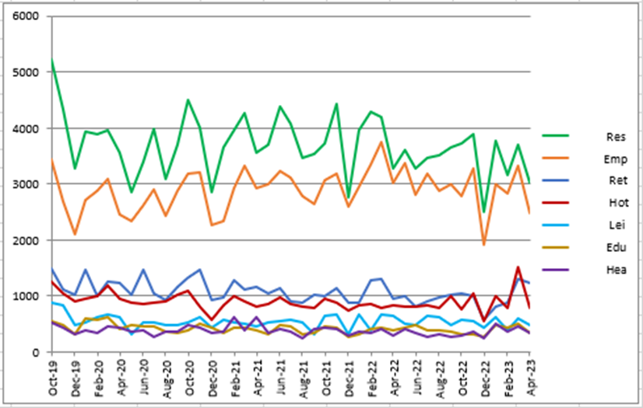
2024: LAND USES REQUESTED BY TRICS USERS
Top 10 preferred land use sub- categories by users (2023 TRICS User Survey)
  Electric Vehicle Charging Station
  Drive Through Coffee Shop
  Discount Food Store
  Convenience Store
  Retirement & Care Community
  Shopping Centre (local shops)
  Business Park
  Warehousing (commercial)
  GP Surgery
  Industrial Estate
Trip Rate Calculations (inclusive of April 2023)
Notes:
The results of the 2023 TRICS User Survey fed into the design of our 2024 data collection programme. As previously mentioned, users are given the opportunity to state their land use sub-category preferences for consideration in the subsequent annual programme, and although we are including 57 land use sub-categories in the 2024 programme, here are the ten most popular sub-categories as requested by the users in the 2023 User Survey.
The image on the right of this slide is one that we regularly use to monitor the level of trip rate calculations undertaken by our users across the 7 biggest main land use types. The most popular main category is Residential, which you can see in green, followed by Employment in orange. In the graph’s lower part, you can see Retail, Education, Health, Hotel Food & Drink, and Leisure. This graph is also used as reference in the design of the subsequent data collection programme, as well as an assessment over time (survey date cut-offs) of surveys by land use-sub-category as well as other assessing factors.

Slide 10
2024: MAIN LAND USES BREAKDOWN
Notes:
Using both the User Survey results and our own technical analysis of the current database, we can start putting together the data collection programme for the subsequent year.
The table and graph in this slide show the number of surveys we plan to conduct in 2024, broken down by the main uses. The numbers are both the vehicles-only and multi-modal surveys combined. As you can see, the land uses allocated wit the most surveys for 2024 are residential, employment and retail, with other main categories following behind these to varying degrees. However, when going on-site visits, we will always include a good mix of development types, allowing us greater flexibility when it comes to shortlisting surveys and including them in regional data collection tenders at a later stage.

Slide 11
2024: REGIONAL COVERAGE
Top 10 preferred regions by users
(2023 TRICS User Survey)
  South West
  East Midlands
  East Anglia
  South East
  West Midlands
  North
  Yorkshire and North Lincolnshire
  North West
  Greater London
  Wales
Notes:
Within the User Survey, the 17 TRICS regions are scored by users in terms of popularity out of 10 (10 being the most popular). Based on the ranking of average scores (which you can see on the following slide), we can then split the data collection programme between all of the regions in a proportionate way.

Slide 12
2024: FINAL DATA COLLECTION PROGRAMME
Total number of surveys: 270
  Level 1 – 120
  Level 2 – 150
Region | Score | Priority | L1 Days | L2 Days | 2024 Days
South West | 7.65 | 1 | 12 | 13 | 25
East Midlands | 7.53 | 2 | 11 | 13 | 24
East Anglia | 7.48 | 2 | 11 | 13 | 24
South East | 7.39 | 3 | 9 | 13 | 22
West Midlands | 7.35 | 3 | 9 | 13 | 22
North | 7.26 | 3 | 9 | 13 | 22
Yorkshire & North Lincolnshire | 7.17 | 4 | 8 | 12 | 20
North West | 7.03 | 4 | 8 | 12 | 20
Greater London | 5.61 | 5 | 6 | 10 | 16
Wales | 4.83 | 6 | 6 | 8 | 14
Scotland | 4.13 | 7 | 5 | 8 | 13
Ulster (Northern Ireland) | 3.41 | 8 | 5 | 6 | 11
Ulster (Republic of Ireland) | 2.97 | 9 | 5 | 4 | 9
Greater Dublin | 2.81 | 10 | 4 | 3 | 7
Connaught | 2.74 | 10 | 4 | 3 | 7
Munster | 2.74 | 10 | 4 | 3 | 7
Leinster | 2.74 | 10 | 4 | 3 | 7
Totals |  |  | 120 | 150 | 270
270 surveys split across the 17 regions based on the User Survey popularity rankings.
Notes:
Having undertaken the full analysis, we can then finalise the data collection proposal for 2024, which is represented in the table shown on this slide. As you can see, the average popularity score out of 10 by region is displayed, with a priority score then being allocated to smaller groupings of regions. As we also know the proposed number of overall Level 1 and Level 2 surveys for the entire programme, we can allocate a number of surveys to each region, and this is what you also see here. You can also see that we are maintaining the original target of 270 surveys that we put forward for the 2023 programme for the 2024 programme.

Slide 13
SHARED LIVING DEVELOPMENTS FOR 2024
03/Q – Shared Living Developments (use class C3)
Apartment developments with additional integrated and communal facilities. Residential units can be rented directly with varying and flexible lengths of occupancy (including short term). Additional facilities may include gyms/fitness studios, shared kitchens, communal lounges, gardens and outdoor areas, cinema/TV rooms, communal workspaces, restaurants/cafes/bars, and other uses such as libraries and games rooms, etc. Trip rates are calculated by Accommodation Units or GFA.
Notes:
Another thing that we have included in the 2024 data collection programme is a new sub-land use category. TRICS is always analysing new trends (and we also ask our users as part of the User Survey to identify potential new sub-categories that we could add to the database). Recently we have noticed the rise of a new type of residential development called Shared Living. These developments have become more popular in recent years, and include flexible rented accommodation with additional communal amenities, so we have added a new sub-category to the database to allow surveys at such developments from 2024 onwards. You can see the definition of this new sub-category on this slide.

Slide 14
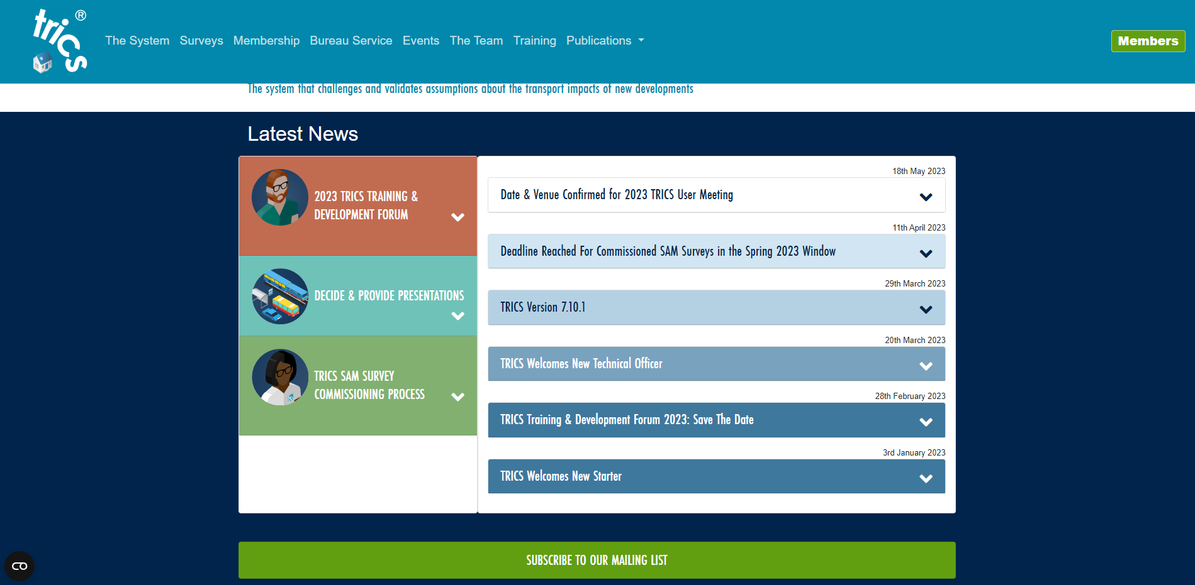
Closing Point
Sign up for our Mail Chimp mailing list.
Notes:
Please sign up for our mailing list. I have a screenshot on the screen of the home page of our website and if you can see the green bar that’s on the bottom of the screen, if you click on that and fill in the mailing form, you will be able to hear from us directly about new features of TRICS, TRICS upcoming events and then next year, be a part of helping us build our survey programme.

